Slide 1
Chainlink Hackathon
may 2022

Slide 2
Main problem: several parties do not trust each other in the sale and transportation of a physical product

Slide 3
Solution: through an escrow system and through Chainlink’s oracle and api system trust can be build so a transaction can be executed for a sale of a physical product and delivery can be done. Payment can be made after delivery

Slide 4
Flow of Product and Statusses
Created
Costs known
Costs deposited
Dropped OFF
Handed Over
Buyer/Seller
Buyer/Seller
Buyer/Seller
Cancelled
Received

Slide 5
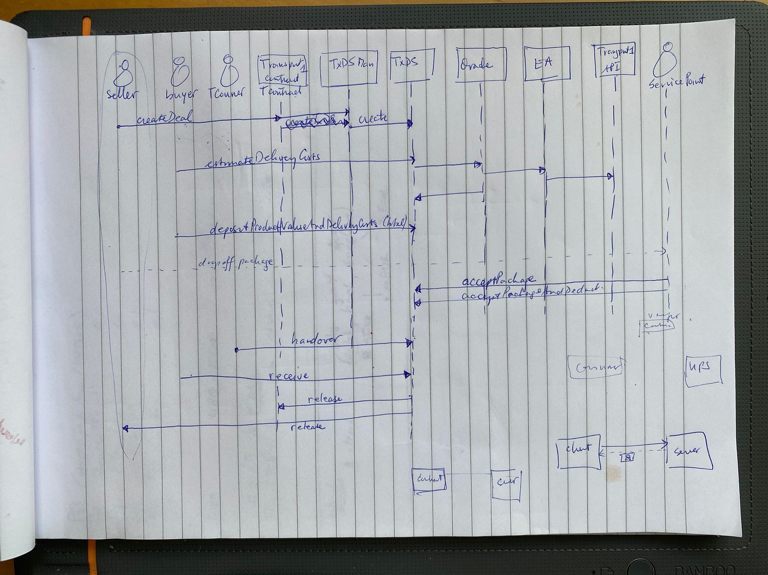

Slide 6
Overview
Onchain
TxDS Manager
TxDS 1
TxDS 2
TxDS 3
Seller
Oracle
OffChain
Chainlink Node
External Adapter
UMC Transporter API

Slide 7
Roles/components of the system
Seller of the product:
Buyer of the product:
Transport courier: delivery man
Transporter smart contract: UMC conrtract
TxDSMan: the Transaction Delivery Service Manager
TxDS: the Transaction Delivery Service

Slide 8
Roles in the system
SOracle: Chainlink Net: Local Node
EA: External Adapter: Transporter UMC
Transport 1 API: Data Source Provider UMC
Service Point: Physical Parcel Drop Off Point of Transport company

